Slide 1

Helpful logging with Python
Thomas Aglassinger
http://www.roskakori.at
v1.1.0

Slide 2


About me
Thomas Aglassinger
Software developer
  Industry experience since 2001 in various areas (health care, banking, e-commerce, customer relationship management)
  Casual open source developer
  2 x MSc
Links
  http://www.roskakori.at
  @TAglassinger
  https://github.com/roskakori

Slide 3

Motivation
Logging is part of non trivial software development
During debugging and tracking down support issues,
developers (and others) spend quite some time looking at log files
Technical aspects of logging are well described, how to use logging in a helpful way - not so much
This talk intends to share experiences
and things that “worked for me”
Somewhat backed up by literature
Source: https://commons.wikimedia.org/wiki/File:Light_bulb_(yellow)_icon.svg

Slide 4
Agenda
Logging with Python – the basics
INFO messages: future vs past
ERROR messages: modes of human error, wording error messages towards solutions, clean error handling
ERROR vs CRITICAL messages: situations where they are appropriate
WARNING messages: when are warnings even useful, how are warnings similar to errors
DEBUG logging

Slide 5
Logging – the basics

Slide 6
Why logging?
Analysis: even after the fact, complements debugging with breakpoints
Monitoring: Can provide triggers for monitoring systems
→ react on certain log messages
Support: collects information even when run on a different computer by another users
Application metrics: answer questions like “How often did a certain error occur in the past 3 months?”

Slide 7
The logging module
Part of standard library
Application can create multiple loggers, e.g. per module
Loggers can log messages at different levels
Messages can be...
  formatted flexibly: timestamp, level, message, logger name, thread, ...
  sent to various outputs: console, log file, data base, network, ...
  filtered as needed: only certain loggers or levels
Documentation: Logging facility for Python

Slide 8
Logging example
import logging
_log = logging.getLogger('example')
if __name__ == '__main__':
logging.basicConfig(level=logging.INFO)
_log.info('hello world!')
_log.debug('located at: %s', __file__)

Slide 9
Logging example
import logging
_log = logging.getLogger('example')
if __name__ == '__main__':
logging.basicConfig(level=logging.INFO)
_log.info('hello world!')
_log.debug('located at: %s', __file__)
Create a new logger
Log level INFO or
higher to console
Will be logged
Message includes
variable
Will be suppressed

Slide 10
Logging levels
DEBUG, INFO, WARNING, ERROR, CRITICAL
Corresponding functions to log a message:
debug(), info(), warning(), error(), critical()
Messages below a certain level can be suppressed using e.g.
someLogger.setLevel() or configuration files
Use getLogger(__name__) to use current module as name
Packages and sub-packages can be controlled hierarchically

Slide 11
Logging the stack trace 1/2
important_data_path = 'no_such_data.txt'
try:
process_data(important_data_path)
except OSError as error:
_log.error('cannot process data file "%s": %s',
important_data_path, error, exc_info=True)
ERROR:example:cannot process data file "no_such_file.txt": [Errno 2] No such file or directory: 'no_such_file.txt'
Traceback (most recent call last):
File "/Users/someone/logging_example.py", line 11, in process_data
with open(data_path, encoding='utf-8') as data_file:
FileNotFoundError: [Errno 2] No such file or directory: 'no_such_file.txt'

Slide 12
Logging the stack trace 2/2
important_data_path = 'no_such_data.txt'
try:
process_data(important_data_path)
except OSError as error:
_log.exception('cannot process data file "%s": %s',
important_data_path, error)

Slide 13
Articles on Python logging
Good logging practice in Python
  The basics
  Configuration using JSON, YAML, INI
Get Started Quickly With Python Logging
  With PyCharm
  Formatting messages
Python Custom Logging Handler Example
  Log to Kafka streaming platform (to collect logs from multiple sources)

Slide 14
Tools to collect and search logs
logstash and kibana (based on elasticsearch)
graylog
nagios core with check_logfiles plugin
Available as basic open source product and fully featured commercial product

Slide 15
INFO logging

Slide 16
Motivation for INFO messages
Quickly see what application is doing right now (or was doing at a certain point in time)
Trace back what caused a certain error
High level
If possible using business terms (process, document, file, customer record, ...)
Small amount of messages to avoid information overflow and excessive impact on log storage

Slide 17
When to use INFO
With high level components: business relevant actions and decisions that influence the result
  Business process start / end
  Input received / output sent
  Major branches in process logic
With low level components: essential operations
  Incoming requests
  Start / end of transactions (database, files, network, …)
  Connection to other services or resources (database)
  Important state changes ( configuration changes, log in, session context, …)
  Start / end of complex calculation, important results
  Progress information (download, calculation, ...)

Slide 18
Logging before / after the fact
Before: use present tense participle (“-ing form”),
for example:
reading customer data from “customers.csv”
After: use past tense, for example:
read 1234 customer records from “customers.csv”

Slide 19
Perspective of log messages
Word log messages from the perspective of the application
I = the application
you = the reader of the log
In line with usability engineering (i.e. status messages, progress bars, error dialogs)

Slide 20
Grammar of log messages
When the application is about to do something: present progressive: for example:
  reading customer data from “customers.csv”
When the application finished doing something: past tense, for example:
  processed 1234 customer records from “customers.csv”
  read 1234 customer records from “customers.csv” [to read = irregular verb]
When the application expects the log reader to do something: imperative (German: Befehlsform), for example:
  check proxy settings
  see section 12.3.4 of the user guide for more information
  visit https://example.com to download the update

Slide 21
Example: no logging
with open(customers_path, encoding='utf-8') as customers_file:
for line in customers_file:
process_customer(line)

Slide 22
Example: basic logging
_log.info('processing customers from "%s"', customers_path)
line_number = 0
with open(customers_path, encoding='utf-8') as customers_file:
for line_number, line in enumerate(customers_file, 1):
process_customer(line)
_log.info('processed %d customers', line_number)
INFO:example:processing customers from ".../customers.txt"
INFO:example:processed 69 customers

Slide 23
Example: progressive logging
_LOG_PROGRESS_THRESHOLD_IN_SECONDS = 3
_log.info('processing customers from "%s"', customers_path)
start_time = time.time()
last_log_time = start_time
line_number = 0
with open(customers_path, encoding='utf-8') as customers_file:
for line_number, line in enumerate(customers_file, 1):
current_time = time.time()
if current_time - last_log_time >= _LOG_PROGRESS_THRESHOLD_IN_SECONDS:
_log.info('processing customer record %d', line_number)
last_log_time = current_time
process_customer(line)
end_time = time.time()
_log.info('processed %d customers in %.2f seconds',
line_number, end_time - start_time)
INFO:example:processing customers from ".../customers.txt"
INFO:example:processing customer record 25
INFO:example:processing customer record 49
INFO:example:processed 69 customers in 8.79 seconds

Slide 24

Example: progressive logging
_LOG_PROGRESS_THRESHOLD_IN_SECONDS = 3
_log.info('processing customers from "%s"', customers_path)
start_time = time.time()
last_log_time = start_time
line_number = 0
with open(customers_path, encoding='utf-8') as customers_file:
for line_number, line in enumerate(customers_file, 1):
current_time = time.time()
if current_time - last_log_time >= _LOG_PROGRESS_THRESHOLD_IN_SECONDS:
_log.info('processing customer record %d', line_number)
last_log_time = current_time
process_customer(line)
end_time = time.time()
_log.info('processed %d customers in %.2f seconds',
line_number, end_time - start_time)

Slide 25

Homework assignment
AbstractProgressiveLoggableStrategyFactory
Source: https://www.youtube.com/watch?v=Tpa1bnhZMis

Slide 26
Summary (so far)
Info-log only essential actions and decisions
When possible use business terms
Mind the grammar for clear wording
  Present progressive tense
  Past tense
I = software, you = log reader
  Imperative to address reader

Slide 27
ERROR logging

Slide 28
Detecting errors
Detect yourself with „if“:
Detect error raised by called function using „except“:
if actual_value != expected_value:
_log.error('...')
try:
do_something()
except OSError as error:
_log.error('...')
For now just log.
Discussion on log vs raise: soon

Slide 29
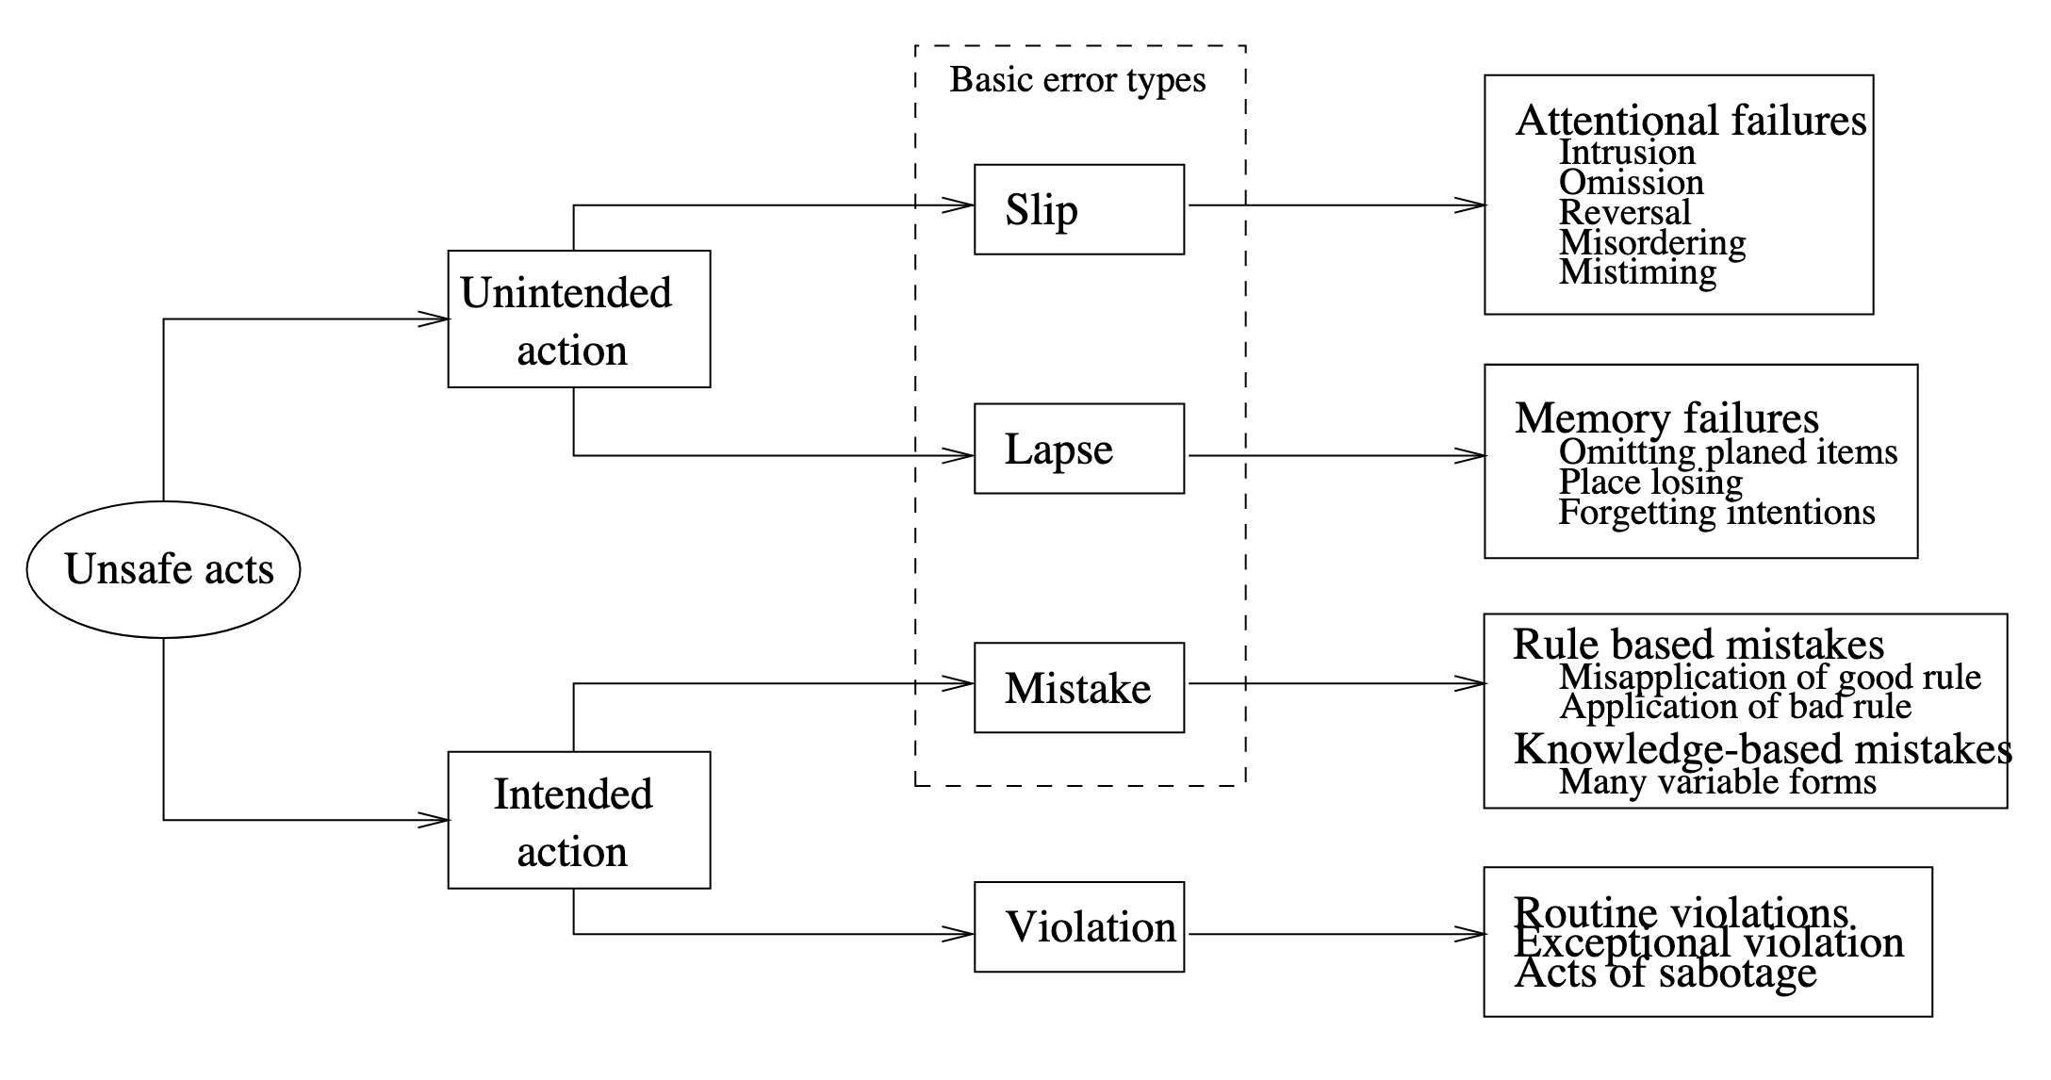
Human error as unsafe acts
Source: J. Reason (1990), „Human Error“, p. 207

Slide 30
Examples for unsafe acts
Slip: person does something they did not intent to and would know better, e.g. type “their” instead of “there”
Lapse: person forgets to do something they intended to do, e.g. exit application without saving
Mistakes: person "intentionally"carries out a sequence of actions that - maybe even possible and correct for the application - do not give them what they want, e.g. try to open text document in spreadsheet application
Violations: e.g. workaround, sabotage

Slide 31
Solving errors
Provide information for the log reader to reflect about the situation that lead to an error
State: spell out what the data where provided / processed
→ particularly helpful to detect slips and lapses
Context: spell out what the software actually was doing
→ particularly helpful to detect lapses and mistakes

Slide 32
Describing the error context
Message should describe the context in which the error was detected
Description should be self contained
  Object that caused error, e.g. file, customer number, session number
  Action that was attempted to be performed, e.g. reading, writing, calculation, creating, connecting, …
  Parameters or values that were attempted to be processed
Previous log messages should only help to find out how this context was reached

Slide 33
Template for error messages
Detect yourself with „if“:
Detect error raised by called function using „except“:
if actual_value != expected_value:
_log.error('some value is %s but must be %s',
actual_value, expected_value)
try:
do_something()
except OSError as error:
_log.error('cannot do something: %s', error)
For now just log.
Discussion on log vs raise: soon

Slide 34
Variants for „detect yourself“
Value cannot be processed: „some value is %s but must…“
  … be between 0 and 100
  … be one of: red, green, blue
  … match format YYYY-MM-DD
Value not found in a large set of possible values:
  „cannot find customer number 1234“
  „cannot find customer number 1234; possible similar customer numbers: 1243, 1324“
Missing required value:
  „date of birth must be specified“
  „data of birth must be specified for age validation“ (explains why value is required)
Unterminated context of recursive descent parsers:
  „string started in line 17, column 23 must be terminated with quote“
  avoid useless “unexpected end of file”

Slide 35
Log or raise error?
Log error: Few parts of the code will log errors
  __main__ before sys.exit(1)
  self contained request handlers / dispatchers that simply continue with next independent request
  form validation → show error and remain in form
Raising error:
  guidelines for wording error message apply
  can’t do anything about it anyway, just report it to the caller

Slide 36
Log and raise error: anti pattern
Spams log with redundant and thus confusing error messages
# BAD EXAMPLE, don't use this template
def process_customers(customers_path: str):
try:
with open(customers_path, encoding='utf-8') as customers_file:
for line in customers_file:
process_customer(line)
except OSError as error:
_log.error('cannot process customer data in "%s"', customers_path)
raise

Slide 37
Use exception chaining instead
Adds context information in new exception
Preserves existing information in chained exception
def process_customers_good(customers_path: str):
try:
with open(customers_path, encoding='utf-8') as customers_file:
for line in customers_file:
process_customer(line)
except OSError as error:
raise SomeError('cannot process customer data in "%s"',
customers_path) from error

Slide 38
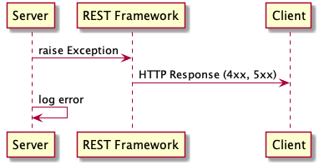
Log and raise error: valid scenario
Frameworks for REST API that convert exception into HTTP response:
  Server raises exception
  REST Framework converts exception
  into 4xx or 5xx HTTP response and
  thus reports error to the client
  Unless server also logs exception,
  information about error would only
  be available to client

Slide 39
Further reading on error handling
Lösungsorientierte Fehlerbehandlung (with Python)
How to write good error messages (with many examples)

Slide 40
CRITICAL messages

Slide 41
Critical errors
When application has to exit in unclean manner
  Resource leaks
  Data loss
Typical before involuntary server shutdown
Inappropriate for:
  Unprocessable single request / command / user input
  Errors during program startup, e.g. missing command line option or broken syntax in configuration file

Slide 42
Wording critical messages
Messages worded similar to ERROR
Example:
CRITICAL: cannot reconnect to database some.db: <some database error>
INFO: shutting down server

Slide 43
WARNING messages

Slide 44
Warnings hint at design issues
INFO is „good“
ERROS is „bad“
WARNING is …?

Slide 45

Warnings hint at design issues
INFO is „good“
ERROS is „bad“
WARNING is …?
Warnings delegate the decision if something is good or bad from the software designer to the user / log reader

Slide 46

But still...
Warnings can be useful under certain circumstances
In general: situations where an error can be fixed by the application
  In a deterministic way
  With a high probability it is what the user wants to do

Slide 47
Wording warnings
Mix of error and info should reflect in the wording
Error part: describes what happened and was expected
Info part: describes what is being done / has been done to improve the situation

Slide 48
Transient errors
External errors that might be going away after a while because the cause went away
Might be able to solve with retries
Example:
WARNING:example: Cannot connect to database some.db, trying to reconnect (attempt 2 of 5)

Slide 49
Reduced quality of service
In environment with multiple redundant components that can perform the same task
Example:
  replicas of search platform
  stateless micro services
request

Slide 50
Reduced quality of service
In environment with multiple redundant components that can perform the same task
Example:
  replicas of search platform
  stateless micro services
Example:
request
WARNING:example: Cannot connect to search server abcd17. Temporarily removing server from pool and delegating request to server abcd18

Slide 51
Using default values
Only appropriate for non business critical information
  Configuration files
  Layout of graphical components
Example:
For single values (e.g. command line arguments): instead of warning make arguments optional and use documented default values (e.g. available with --help)
WARNING: Cannot read configuration from „~/.somerc“,
using default configuration in „/opt/some/defaultrc“

Slide 52
DEBUG messages

Slide 53
Debug messages
Target audience
  debug: developers familiar with the code
  any other log level: devops, operations, users, …
Wording
  if possible similar to INFO
  otherwise: whatever rocks your boat
    names of classes, methods, variables
    dumps of XML, JSON, request headers
    escaped string, hexadecimal garble
    ...

Slide 54

Amount of information
On other log levels, numbers of messages was as small as possible
Debug messages can be many because the application normally does not run with log level set to DEBUG
Source: https://knowyourmeme.com/memes/zerg-rush

Slide 55
Enabling debug logging
Only temporarily while tracing an issue
Otherwise: too much strain on storage and collection of logs
Enable only for loggers that are expected to contain relevant information
Consider adding a mechanic to your application that allows to change log levels during runtime

Slide 56
Various topics

Slide 57
Performance
Use log patterns instead of resolved or formatted strings
Log expensive to obtain information only if logging level is appropriate
# BAD: always compute number even if might not be logged
_log.debug('processing %f foos', some_computed_number())
# GOOD: conditional logging of computed information
if _log.isEnabledFor(logging.DEBUG):
_log.debug('processing %f foos', some_computed_number())
# BAD: Format strings for logging
_log.debug(f'{name} has a size of {size}cm')
# GOOD: debug log plain strings
_log.debug('%s has a size of %dcm', name, size)

Slide 58
Scaling considerations
Log asynchronously to not slow down applications
Challenge: log messages from multiple (possibly thousands of) sources are collected in a single log platform
  Use transaction / source ID in log message
  Consider possible multiple log messages from different sources within the same milli second
  Don’t log warnings for reduced quality of service → pointless because something is always broken
Use streaming platforms like Kafka to quickly collect log entries and store them later
Be aware that some logging platforms sort by time received instead of time logged (e.g. graylog)
„30 best practices for logging at scale“
Thanks, https://mgit.at/!

Slide 59
Security: what not to log
Sensitive business data
  Passwords
  Credit card numbers
  Session identifiers
  Account numbers
Personally identifiable information
  Social security numbers (mostly USA problem though)
  Birth dates
  Full names
  Email addresses
  Driver’s license numbers
Source: Get Started Quickly With Python Logging

Slide 60
Operations
Logging to text file
  Messy regular expressions to split log line into timestamp, level, message etc
  Possible injections issues with line breaks
Logging to structured format (e.g. JSON)
  Log entry is already separated into timestamp, level, message etc
  Messages can have line breaks

Slide 61
Conclusion

Slide 62
Summary
INFO:
  doing vs done
  Focus on business logic
  Keep amount of messages low
ERROR:
  “cannot do something: something must be something else“
  Log vs raise, avoid log and raise
CRITICAL: like error but only if the application cannot recover
WARNING
  Might hint at design issues
  Few valid situations
  Combines error and info message
DEBUG
  For developers
  Log whatever is necessary

Slide 63
Questions and answers
Thomas Aglassinger
http://www.roskakori.at
@TAglassinger

